Slide 1
Pipeline Repairs Improvement Project
(Data Analysis Report out)
Chuks. Bisike-Ojiako
Greg Esangbedo
Approved By: Emeka Maduekwe

Slide 2
OBJECTIVES OF THIS ENGAGMENT
Seek project steering team approvals on the following:
Sign off and approval for the data analysis outcome
To drive Lean Improvements in the two focused areas as indicated in the data analsysis
To include the Project delivery accountability in the GPAs of the persons nominated as PMs and Project Team members

Slide 3
Introduction & BACKGROUND
Towards the end of 2013, the PDLT initiated a CI/BI improvement on pipeline repair. The key objective of the exercise is to improve the pipeline repair process and all associated support process to the pipeline repair activity. To achieve this objective, the pipeline LT and CI decided to commence the project by gathering the necessary data - this data will help the improvement exercise focus specifically on the relevant areas that need improvement.

Slide 4
Introduction & BACKGROUND
The Objectives of the entire project are:
To collate data with which to use to understand the lead times of actual pipeline repair and lead times of the associated services supporting pipeline repair
To provide a measure of actual performance of the pipeline repair process and the dependent services associated with the process. - !!!WE ARE HERE
To drive further improvements by showing potential areas (through data analysis) in which the current process can be improved

Slide 5
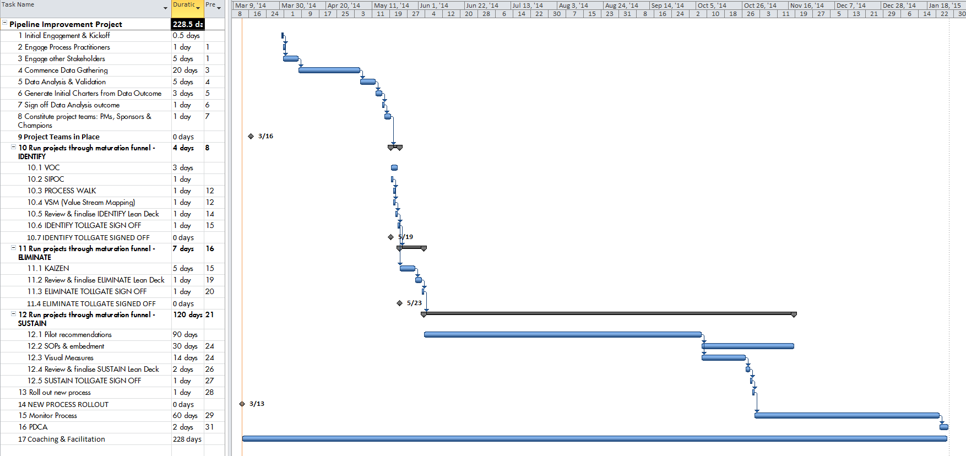
Pipeline improvement project- draft project schedule

Slide 6
Data collection process
Data collection started with an initial review with Pipeline Asset Manager for Steers
Draft data collection Template was produced and reviewed with all stakeholders –Pipelines Ops, Mtc, HSE, Security, etc
Feedback from the review was incorporated with a further and final review with relevant stake holders – Pipeline Mtc, Ops, HSE, Security, Logistics, etc
Data gathering commenced Wednesday 9th of April for 20 days (ended 29th April 2014)
Data was collected for each activity in the Pipeline repair process for
Land and Swamp simple operations
Swamp complex operations (cofferdam)
Normalized data was sent to all data collectors for validation on Fri 5/23/2014 11:02 validation
Results of the analysis was finalized and shared

Slide 7
DATA ANALYSIS – KEY HIGHLIGHTS
Data was analyzed using
Simple Dot plots to ascertain independently the duration of each activity in the pipeline repair process
Pareto analysis was used to further validate the findings in the dot plot
The data analysis results indicated 2 key focus areas
PTW/Security Clearance process Improvement
Mobilization & JIV Execution process Improvement

Slide 8
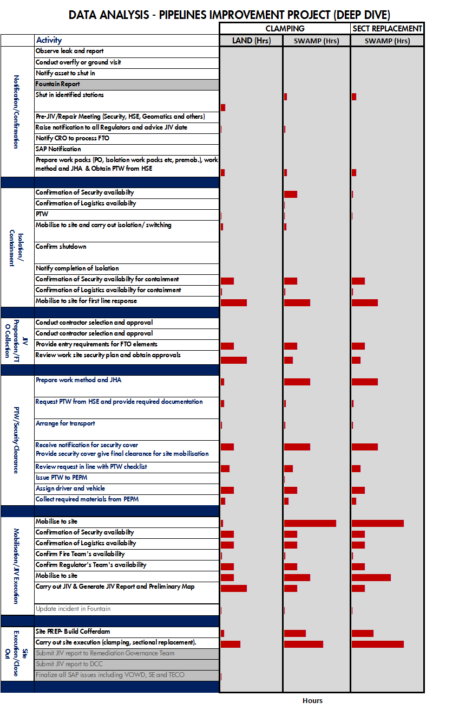
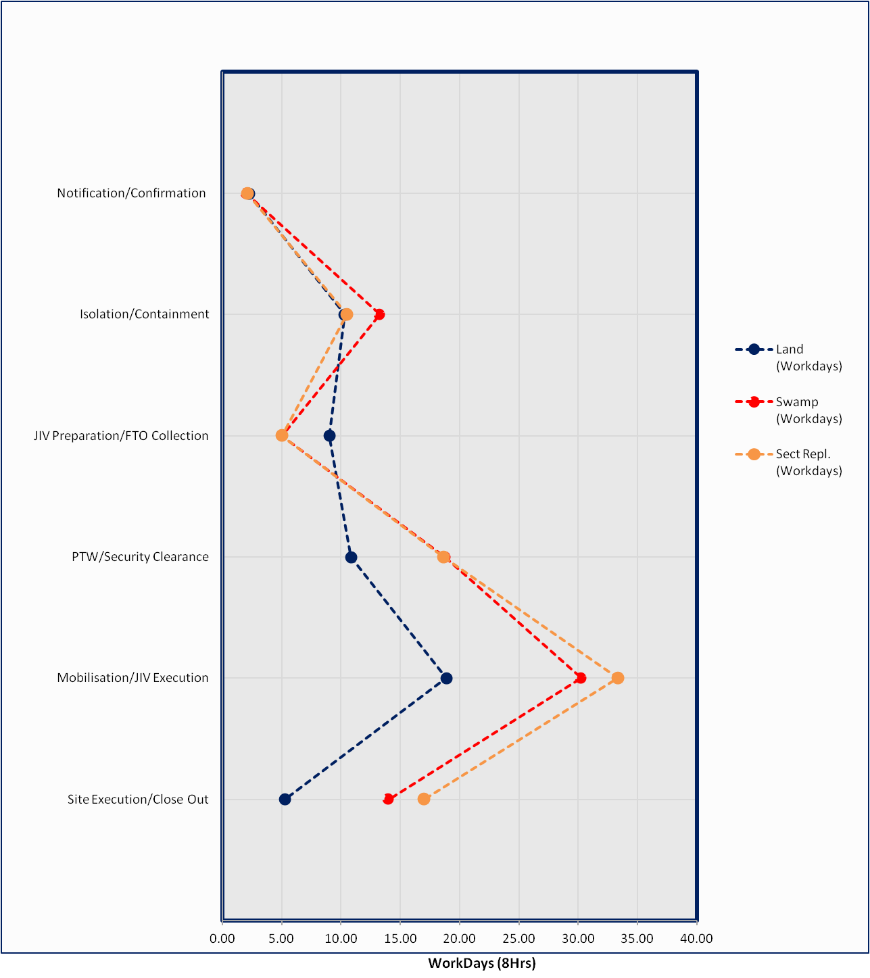
Data analysis outcome
Focus Area for Improvement
Focus Area for Improvement
Objective

Slide 9
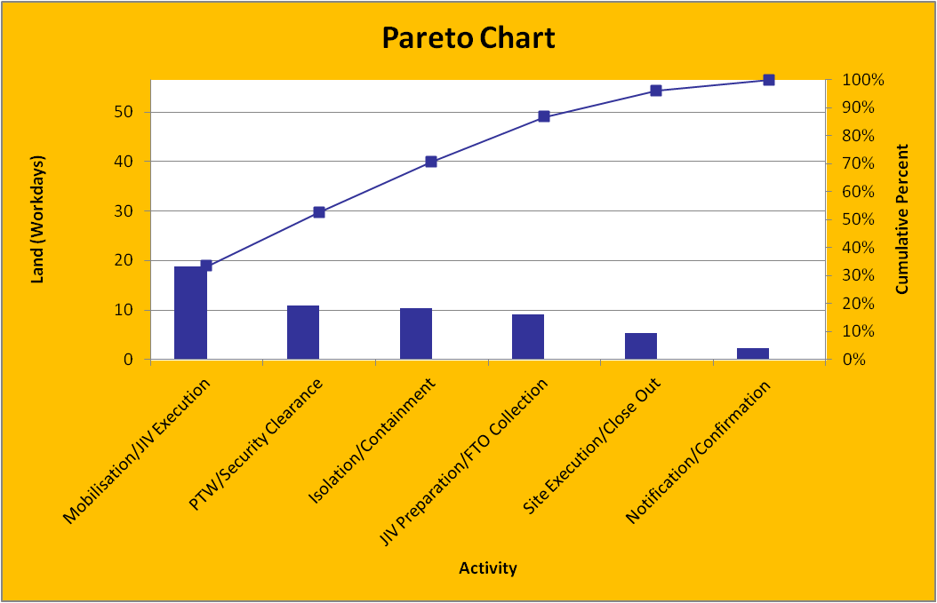
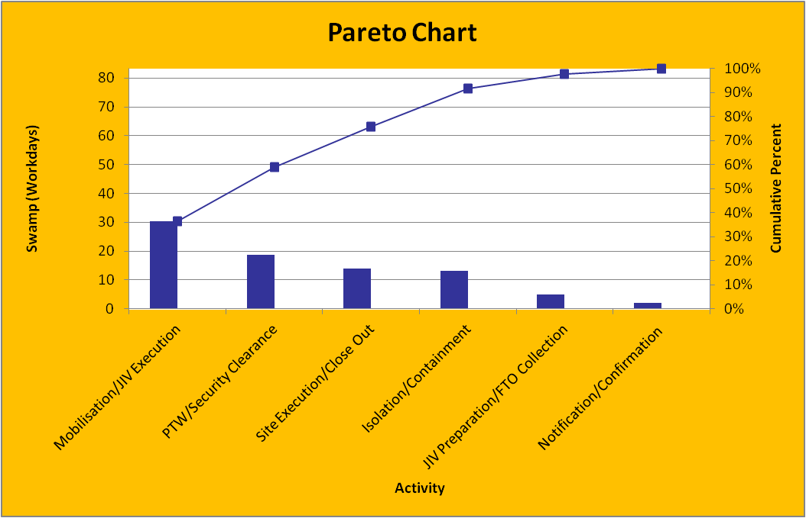
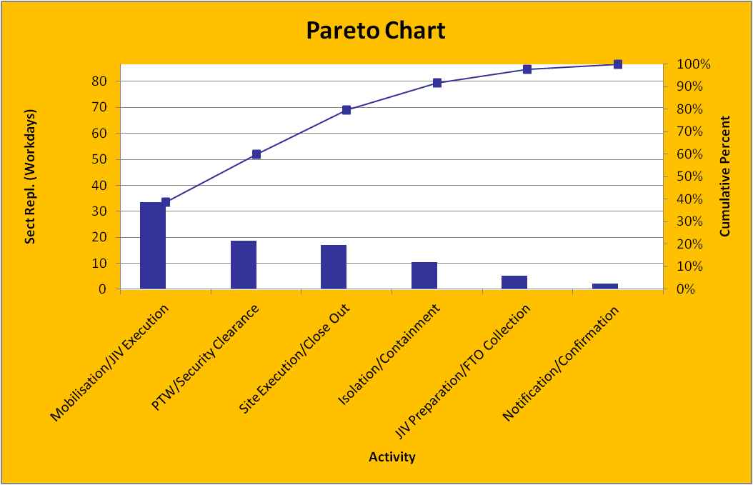
Pareto analysis
Land
Swamp
Sect Repl - Swamp

Slide 10
APPROVALS
Approval is sought for the following
For a sign off and approval of the data analysis outcome
Approve the constitution of 2 CI teams (PMs, Project Teams, Sponsors) to focus on the two key areas indicated by the data analysis outcome
Drive the 2 projects through the Lean project maturation funnel based on the schedule
To include the Project delivery accountability in the GPAs of the persons nominated as PMs and Project Team members

Slide 11
Suggested project representation
PTW/Security Clearance process Improvement | Mobilization & JIV Execution process Improvement
Project Manager | Project Manager
Pipeline HSE | OSRT
Corporate HSE | Pipeline Security
Pipeline Mtc | Coporate Security
Pipeline Ops | Pipeline Mtc
Logistics | Pipeline Ops
Pipeline Security | Logistics
Coporate Security | CI Coach: Greg Esangbedo
CI Coach: TBA

